Slide 1
Production in a desert lizard as a consequence of prey availability and annual variation in climate
R. Anderson¹, L. McBrayer², C. Fabry¹, and P. Dugger¹
¹Western Washington University, ²Georgia Southern University

Slide 2
Introduction
1
Trophic interactions in desert systems are presumed to be strongly linked.
It is reasonable to hypothesize that the annual trophic patterns in desert scrub communities are strongly influenced by annual variation in temperature and precipitation. That is, bottom-up effects in production, from plants to herbivores to secondary consumers carnivores and tertiary consumers (mesopredators and apex predators) should be evident, commensurate with short term effects of climate.
We tested the foregoing hypothesis by analyses of 1) individual lizard body condition, 2) lizard abundance from year to year, 3) annual productivity of the lizard’s prey, and annual, short-term climatic patterns in temperature and precipitation.

Slide 3
Subject Animals
2
Apex, mesopredator as “Tertiary” consumer*:
  Leopard Lizard, Gambelia wislizenii
Insectivores as “Secondary” consumers*:
  Western Whiptail Lizard, Aspidoscelis tigris
  Desert Horned Lizard, Phrynosoma platyrhinos
Insects as “primary” consumers*:
  Grasshoppers, cicadas, termites, ants, and more
    *obviously, trophic levels are mixed for many animals

Slide 4
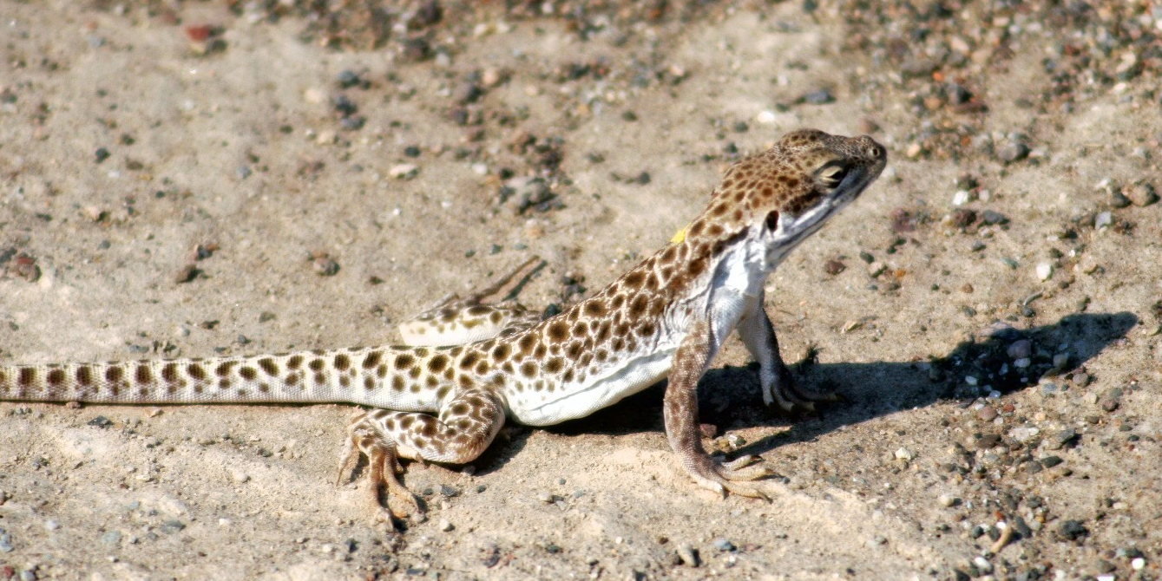
3
Male leopard lizard, Gambelia wislizenii in classic ambush predation pose.
It eats large arthropods, especially grasshoppers, and other lizards.

Slide 5
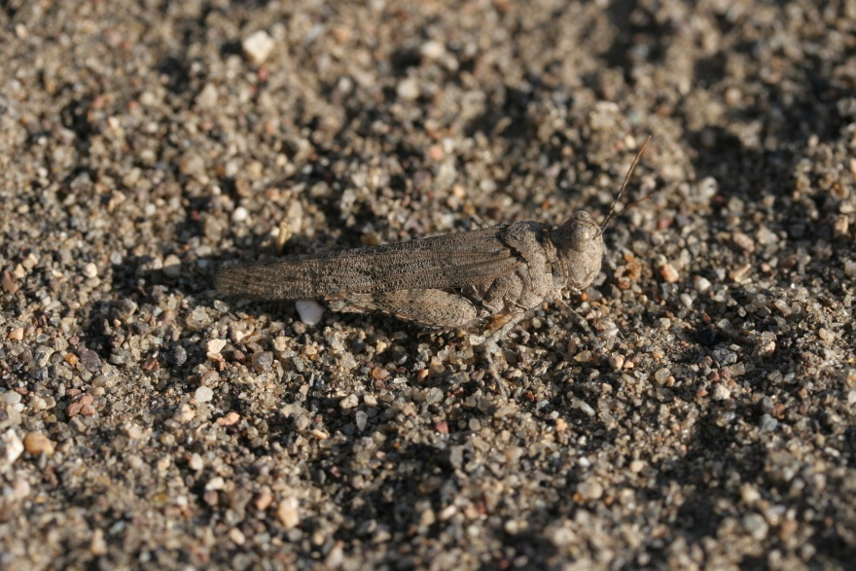
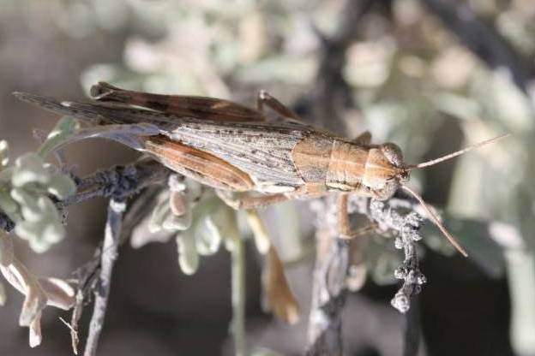
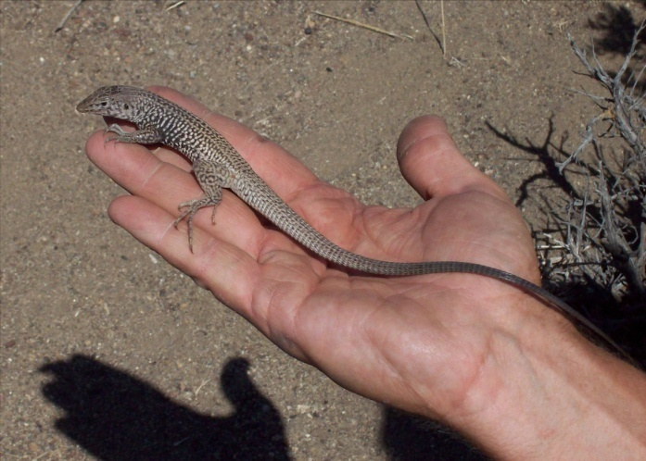
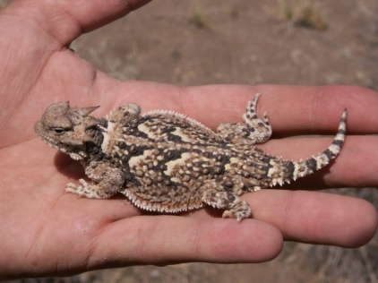
4
Grasshoppers on foliage
Grasshoppers in the open
Prey of the leopard lizard, Gambelia wislizenii
Western whiptail lizard
Aspidoscelis tigris
Desert horned lizard
Phrynosoma platyrhinos

Slide 6
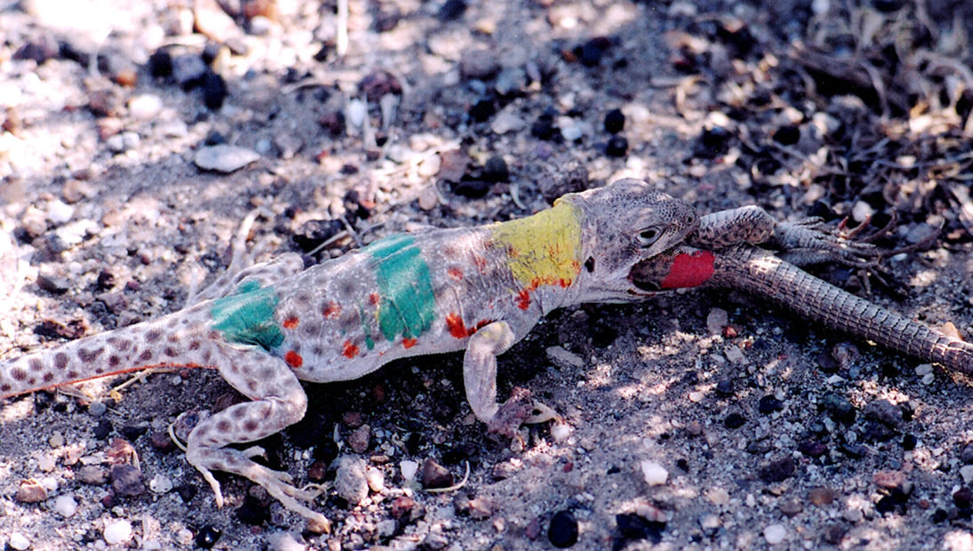
5
Marked female Gambelia wislizenii eating
western whiptail lizard, Aspidoscelis tigris.

Slide 7
Research Site
6
  Alvord Basin, Harney Co, OR
  BLM administered public land
  Great Basin desert scrub
    20% cover by perennial vegetation
    Mix of sandy flats, dunes, and hardpan mesohabitats
  Dominant perennial shrubs:
    Basin big sage, Artemisia tridentata
    Greasewood, Sarcobatus vermiculatus

Slide 8
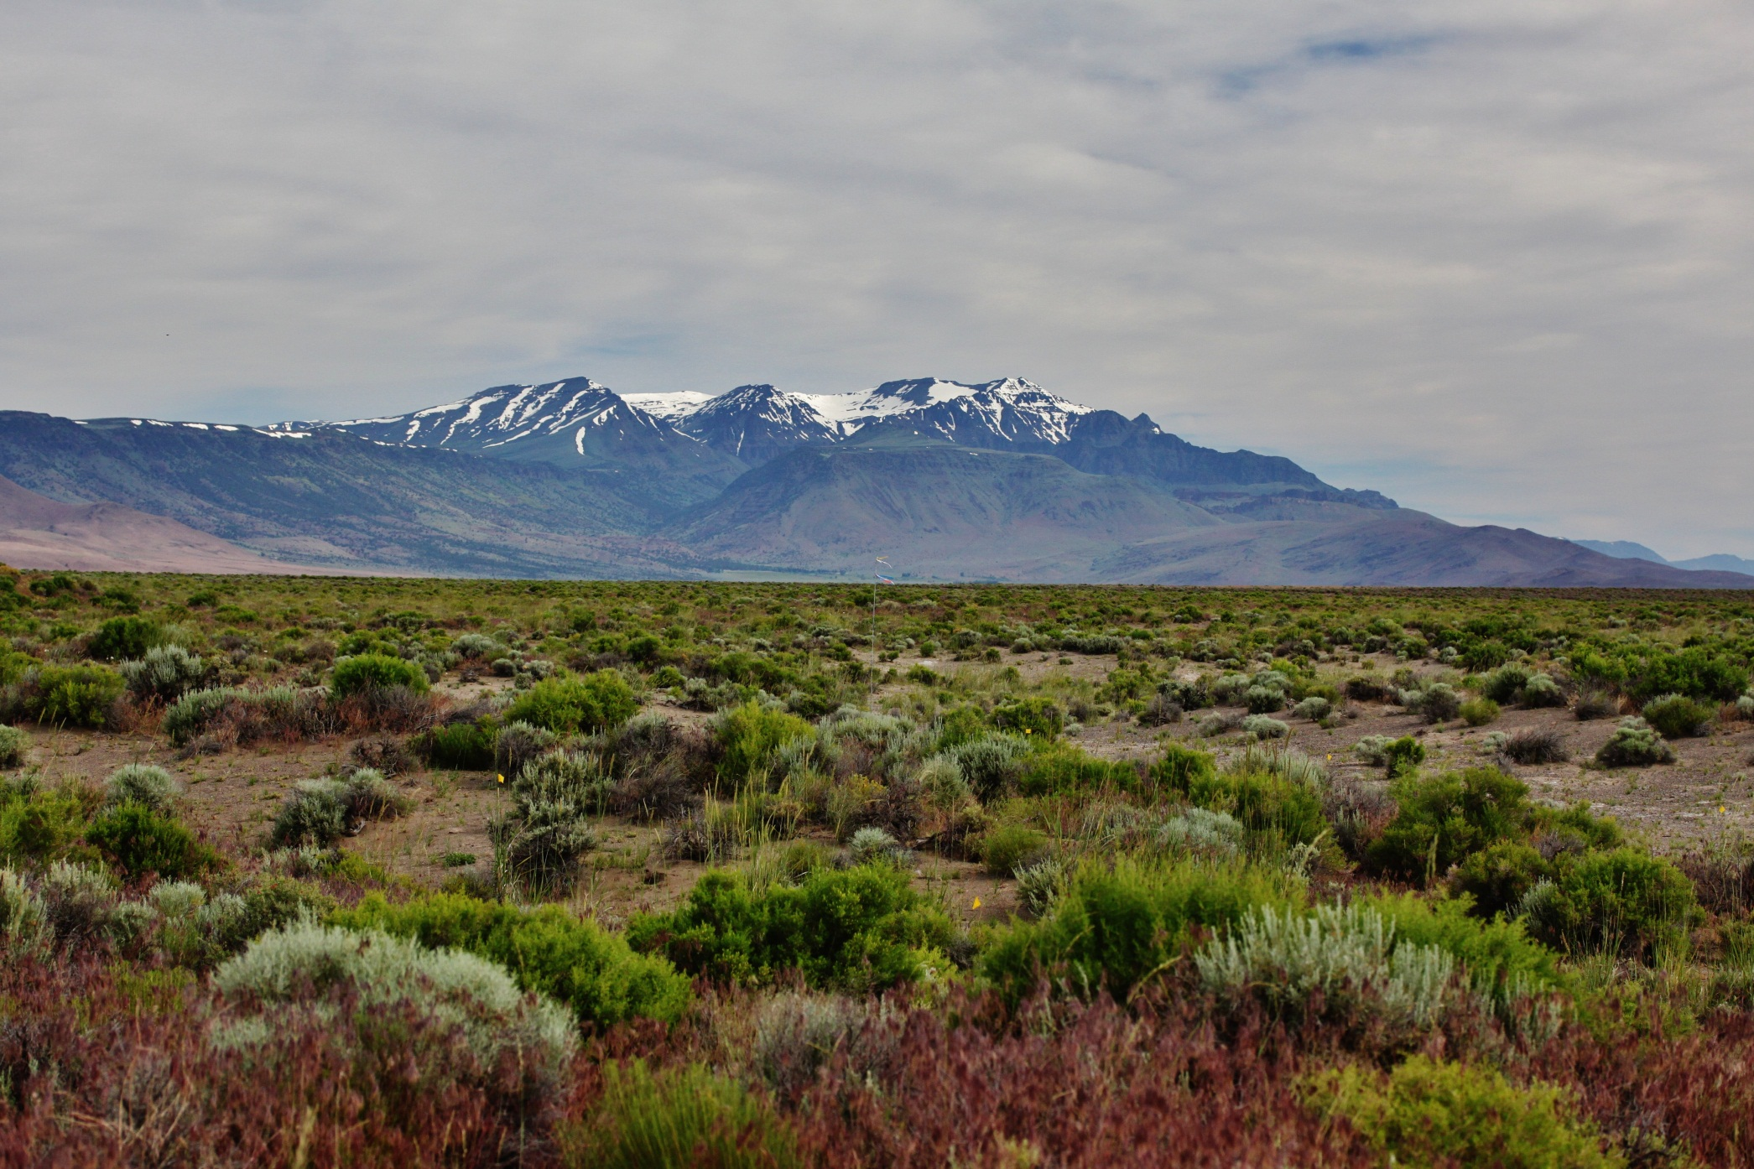
7
On plot, view northward of Alvord Basin, with Steens Mountain, June 2011.
(note the extensive cheatgrass in foreground)

Slide 9
Methods
8
Research period ~June 25 to July 16, 2003-2011
Standard plot surveys for grasshoppers
Standardized annual pitfall trapping
Annual census of lizards on a 4 ha core plot
Capture-mark-release of more lizards near plot
Weather records in the field, greatly buttressed from weather station in nearby Fields, OR, compiled by the DRI, under auspices of WRCC.

Slide 10
Monthly mean daily air temperatures near study site (Fields)
and other weather stations
9

Slide 11
10
Month to month precipitation patterns near study site (Fields)
and at other weather stations in the region

Slide 12
Four dominant grasshoppers on plot, 2003-2009
Proportion
(mean)
Trimerotropis pallidipennis 0.51
(Pallid winged gh)
Cordillacris occipitalis 0.29
(Spotted winged gh)
Melanoplus rugglesi 0.09
(Nevada sage gh)
Parapomala pallida 0.07
(Mantled toothpick gh)
11
Sample sizes:
Values are means from 3 counts for each for 2-3 time periods, for each of 9 days on eight 5mx5m quadrats,
with 8 quadrats per 10mx40m plot , 3 plots per meso habitat, per two mesohabitats.

Slide 13
12
Annual variation in number of grasshoppers counted on plot in early July, as related to air temperatures in prior months
2004
2003
2007
Sample sizes:
Values are means from 3 counts for each for 2-3 time periods, for each of 9 days on eight 5mx5m quadrats,
with 8 quadrats per 10mx40m plot , 3 plots per meso habitat, per two mesohabitats.

Slide 14
13
Sample sizes:
Values are means from 3 counts for each for 2-3 time periods, for each of 9 days on eight 5mx5m quadrats,
with 8 quadrats per 10mx40m plot , 3 plots per meso habitat, per two mesohabitats.

Slide 15
14
Linear regression of log-transformed body mass to snout-vent length ratio of Gambelia wislizenii for each year during the 2003-2009 summer field seasons relative to the mean daily maximum temperature during the preceding May. Numbers for G. wislizenii body mass/snout-vent length ratio were transformed by adding 1, then taking the log of each data point [log(1+(GW body mass/SVL)) = 0.159 – 0.00289(Temperature)].

Slide 16
Body condition of male Gambelia wislizenii as presumed
function of availability of its primary arthropod prey
15
Linear regression of male Gambelia wislizenii (GW) body condition (g body mass per mm snout-vent length) as a function of log-transformed grasshopper-and-cicada availability (log of the sum of the mean number of grasshoppers per site visit and 6 times the mean number of cicadas per site visit, assuming 6 grasshoppers per cicada by weight) per site visit, for each year during the 2003-2009 summer field seasons.
(log(GH+Cicada) = 0.0480 (GW body mass/SVL) + 0.212).

Slide 17
16
Spearman Rank Analysis of factors affecting lizard body condition
Male Gw Mass/SVL | G-hopper Counts | G-hopper + May weather | May Max Temps | May Rain | Winter Min Temps
0.249(5) | 13.9(2) | 5(1) | 19.9(1) | 2(1) | -2.27(1)
0.275(1) | 18.7(1) | 8(2) | 20.1(2) | 5(2) | -2.57(2)
0.258(3) | 5.1(5) | 17(4.5) | 22.5(4) | 9(4.5) | -4.37(3)
0.212(6) | 1.8(6) | 23(6) | 24.0(6) | 12(6) | -5.02(5)
0.259(2) | 5.4(4) | 13(3) | 20.3(3) | 5(3) | -5.34(6)
0.250(4) | 5.9(3) | 17(4.5) | 23.2(5) | 9(4.5) | -4.61(4)
r_{s} | 0.901* | 0.887* | 0.890* | 0.868* | 0.813
Asterisks denote significant correlations at N = 6 and α = 0.05 (r_{s} > 0.829).

Slide 18
17
Patterns of Arthropod Abundance in Pitfall Traps 2004-2011
Analysis of Variance*
Source Type III SS df Mean Squares F-ratio p-value
Year 357,964.706 7 51,137.815 75.328 0.0001
Mesohabitat 31,120.345 2 15,560.172 22.921 0.0001
Plant Species 10,577.248 1 10,577.248 15.581 0.000
Plant Size 2,503.398 2 1,251.699 1.844 0.159
Error 494,893.417 729 678.866
*Post hoc tests revealed these significant differences in annual abundances:
Higher in 2005, 10, and 11 relative to 2004 and 2006-09
Rainfall total in both May 2010 & 2011 were about 3.75 cm

Slide 19
18

Slide 20
19

Slide 21
Among year patterns of 1yr olds recruited to predator and prey populations (see fig 19)
20
#1 yr #Older Gw #1 yr #Older At #1 yr #Older Pp
2004 6 66 24 75 8 42
2005 38 115 10 77 17 31
2006 8 131 8 41 17 31
2007 6 69 7 30 18 35
2008 1 104 1 64 3 43
2009 4 79 5 37 13 45
2010 24 101 8 97 21 27
2011 19 85 7 70 24 31
14% /yr 14%/yr 42%/yr

Slide 22
Conclusions
21
Short term climatic extremes in both the inactivity season and activity season may have a direct effect on arthropod prey abundance.
Short term climatic variation in temperature and rainfall results in similar temporal variation of productivity at the lower trophic levels.
Productivity at the lower trophic levels affect productivity at higher trophic levels.
Higher temperatures during daily and seasonal activity periods may have debilitating energetic consequences for mesopredators and apex predators in seasonal environments, particularly if precipitation is low and the bottom-up trophic energy flow is slowed.
More detailed and integrative analyses of the population dynamic patterns of the mesopredator, its vertebrate prey, and their prey may provide further insights to desert trophic interactions.
See the last figure (panel 23) for summary of the interactions

Slide 23
Flowchart of hypothesized and observed abiotic and biotic
trophic interactions in the Alvord Basin desert scrub.
22
Arrow size denotes relative strength of observed effects

